Slide 1
Design and Analysis of Algorithms
CS602
Lecture 21
Amortized analysis - I
(A powerful tool to analyse algorithm)

Slide 2
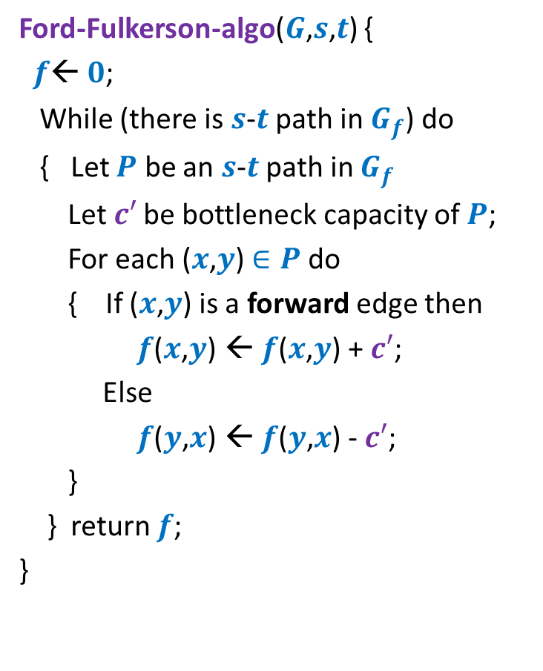


Algorithm 2
Ford-Fulkerson-algo($G$,$s$,$t$) {
$f$← $0$;
While (there is $s$-$t$ path in $G_{f}$) do
{ Let $P$ be an $s$-$t$ path in $G_{f}$
Let$c′$ be bottleneck capacity of $P$;
For each ($x$,$y$) $∈P$ do
{ If ($x$,$y$) is a forward edge then
$f$($x$,$y$) ← $f$($x$,$y$) + $c′$;
Else
$f$($y$,$x$) ← $f$($y$,$x$) - $c′$;
}
} return $f$;
}
Algorithm-2($G$,$s$,$t$) {
Let $P$ be the shortest $s$-$t$ path in $G_{f}$;

Slide 3









A crucial Insight
Lemma: Distance from $s$ to each vertex in $G_{f}$ increases monotonically in Algorithm-2.
$$δ_{f′}\left(s,x\right)≥δ_{f}\left(s,x\right)$$
$$δ_{f}(s,x)$$
$$s$$
$$t$$
$$x$$
$$G_{f}$$
After $i$th Iteration
$$δ_{f′}(s,x)$$
$$s$$
$$t$$
$$G_{f′}$$
$$x$$
Was given as a Homework

Slide 4





Proof by contradiction
$δ_{f′}\left(s,x\right)<δ_{f}\left(s,x\right)$
Let $x$be the nearest “defaulter”.
➔ For each vertex $v$in $G_{f′}$ with $δ_{f^{′}}\left(s,v\right)<δ_{f′}(s,x)$,
$δ_{f}\left(s,v\right)≤δ_{f′}\left(s,v\right)$
$$δ_{f}(s,x)$$
$$s$$
$$t$$
$$G_{f}$$
$$x$$
$i$th Iteration
$$δ_{f′}(s,x)$$
$$G_{f′}$$
$$s$$
$$t$$
$$x$$

Slide 5








Proof by contradiction
Definitely $δ_{f}\left(s,u\right)≤δ_{f′}\left(s,u\right)$
➔ edge $\left(u,x\right)$ must have appeared in residual network after $i$th iteration.
➔Edge $\left(x,u\right)∈P$ (the path selected during $i$th Iteration)
➔ $δ_{f}\left(s,u\right)=δ_{f}\left(s,x\right)+1$
$$δ_{f}(s,x)$$
$$P$$
$$s$$
$$t$$
$$G_{f}$$
$$x$$
$$u$$
$$u$$
$i$th Iteration
?
$$G_{f′}$$
$$s$$
$$t$$
$$u$$
$$x$$
contradiction
$>δ_{f′}\left(s,x\right)+1$
$=(δ_{f^{′}}\left(s,u\right)+1)+1$
$δ_{f}\left(s,u\right)>δ_{f′}\left(s,u\right)$

Slide 6
Amortized Analysis

Slide 7

Binary Search Trees
Examples:
AVL tree
Red-Black tree
Strength:
Achieve worst case O(log $n$) time for all operations.
Weakness:
Very difficult to implement.
Splay tree
Can we have a simpler BST ?

Slide 8
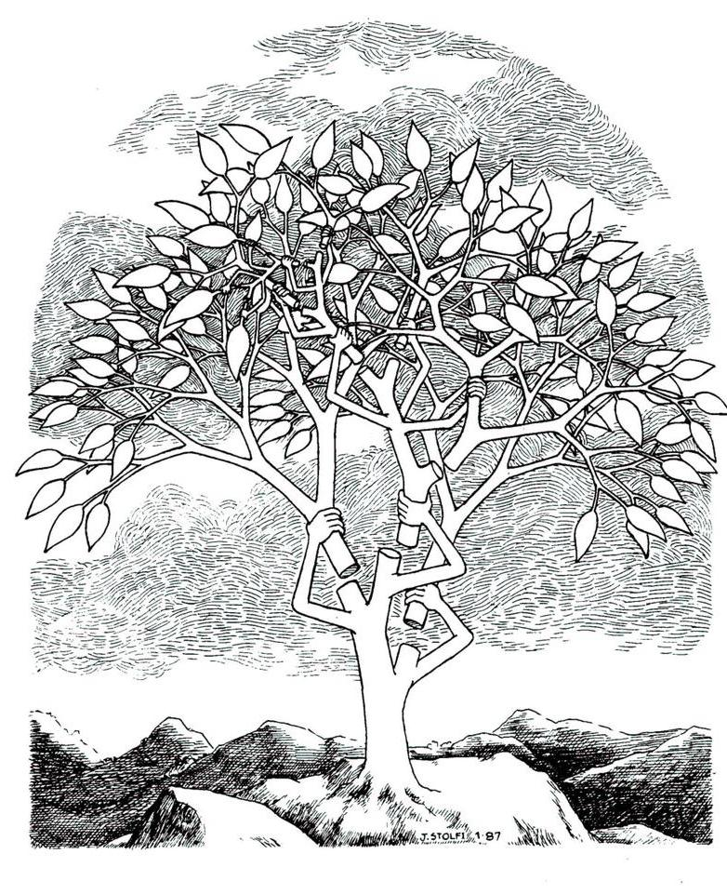

Splay tree: A self organizing Binary search trees.
Daniel Sleator
&
Robert Tarjan
JACM $1985$

Slide 9
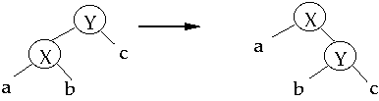
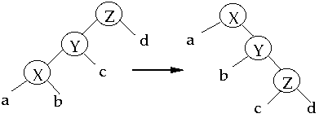
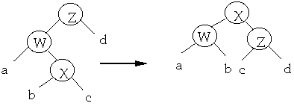
Splay operation
Splay(x)
Single rotation
Zig
Zig-zig
Double rotation
Zig-zag

Slide 10
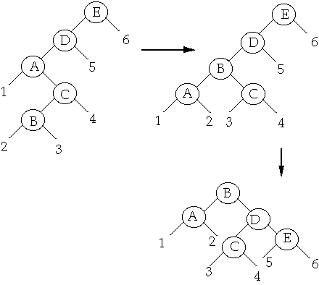
Splay operation
Splay(B)

Slide 11


Search($x$) on a Splay Tree
Perform ordinary search for $x$ on the BST.
Bring the element $x$ to the root by a sequence of splaying.

Slide 12



A magic
Insertion ?
Deletion ?
Any arbitrary BST on $n$ keys
Any arbitrary $m$search operations
Time taken : ??????
O(($m+n$) log $(m+n)$).
EQUALLY SIMPLE
Used in GCC compilers

Slide 13
Amortized Analysis

Slide 14

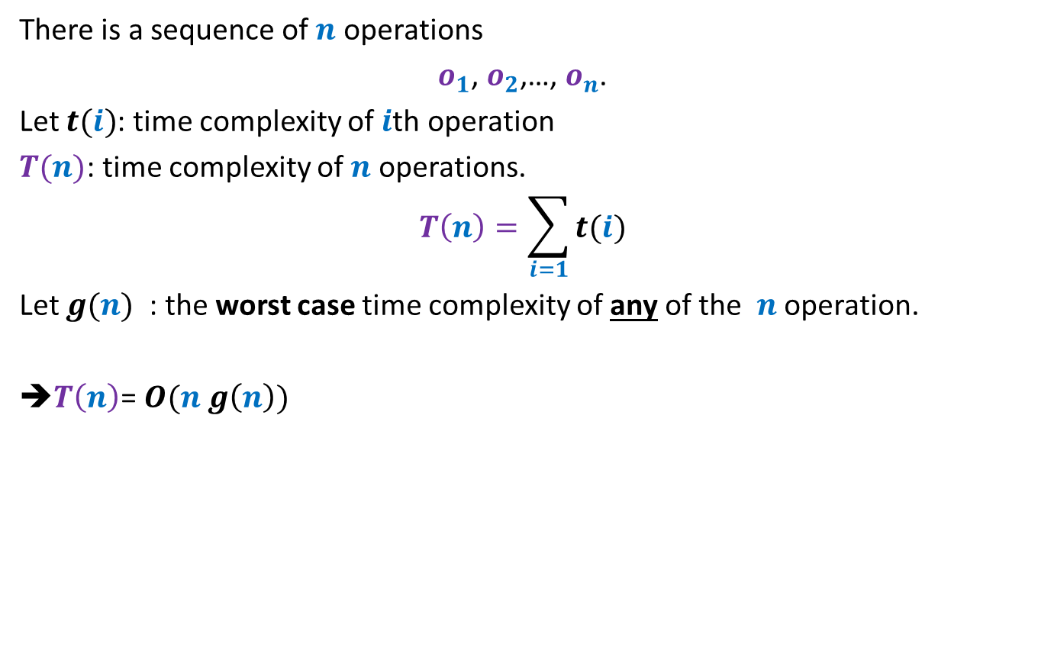


When there is a huge variation in the time complexity of
$o_{1}$, $o_{2}$,…, $o_{n}$
There is a sequence of $n$ operations
$o_{1}$, $o_{2}$,…, $o_{n}$.
Let $t(i)$: time complexity of $i$th operation
$T(n)$: time complexity of $n$ operations.
$$T\left(n\right)=\sum_{i=1}{t(i)}$$
Let $g(n)$ : the worst case time complexity of any of the $n$ operation.
➔$T\left(n\right)$= $O(n g\left(n\right))$
$$g(n)$$
This may be
grossly wrong.
$$t(i)$$
operations

Slide 15

Problem 1
Bit flips during $n$ increment operations

Slide 16
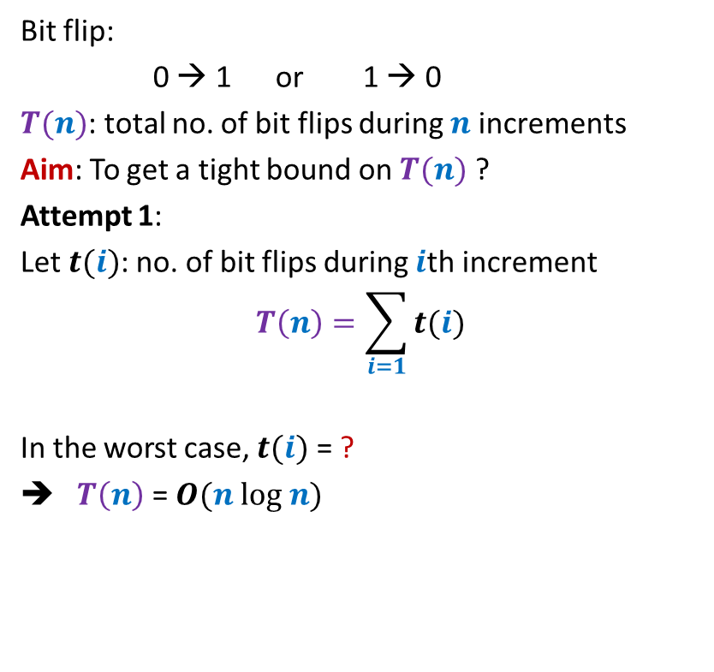


Bit flips during $n$ increment operations
Bit flip:
0 → 1 or 1 → 0
$T(n)$: total no. of bit flips during $n$ increments
Aim: To get a tight bound on $T(n)$ ?
Attempt 1:
Let $t(i)$: no. of bit flips during $i$th increment
$$T\left(n\right)=\sum_{i=1}{t(i)}$$
In the worst case, $t(i)$ = ?
➔ $T\left(n\right)$ = $O(n log n)$
0 0 0 0 1 0 0 1
0 0 0 0 1 0 0 0
0 0 0 0 0 1 1 1
0 0 0 0 0 1 1 0
0 0 0 0 0 1 0 1
0 0 0 0 0 1 0 0
$$1+\log_{2} i$$
0 0 0 0 0 0 1 1
0 0 0 0 0 0 1 0
0 0 0 0 0 0 0 1
0 0 0 0 0 0 0 0

Slide 17







Bit flips during $n$ increment operations
Bit flip:
0 → 1 or 1 → 0
$T(n)$: total no. of bit flips during $n$ increments
Aim: To get a tight bound on $T(n)$ ?
Attempt 2:
$f(i)$:
$$T\left(n\right)=\sum_{i=0}{f(i)}$$
$f(0)$ = ?
$f(1)$ = ?
$f(2)$ = ?
$f(i)$ = ?
➔
$$T\left(n\right)=n\sum_{i=0}{2^{−i}}$$
0 0 0 0 1 0 0 1
0 0 0 0 1 0 0 0
no. of times $i$th bit flips during $n$increments
0 0 0 0 0 1 1 1
0 0 0 0 0 1 1 0
0 0 0 0 0 1 0 1
$$n$$
$$n/2$$
0 0 0 0 0 1 0 0
$$n/4$$
0 0 0 0 0 0 1 1
$$n/2^{i}$$
0 0 0 0 0 0 1 0
0 0 0 0 0 0 0 1
$$<2n$$
0 0 0 0 0 0 0 0
7 6 5 4 3 2 1 0

Slide 18
Problem 2
STACK with multi-pop

Slide 19


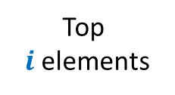





Stack with multi-pop
Push($S$,$x$)
Multi-pop($S$,$i$)
Time complexity = $c$
$$S$$
$$S$$
Top
$i$ elements
Time complexity = $i$ $c$
$$S$$
$$S$$

Slide 20

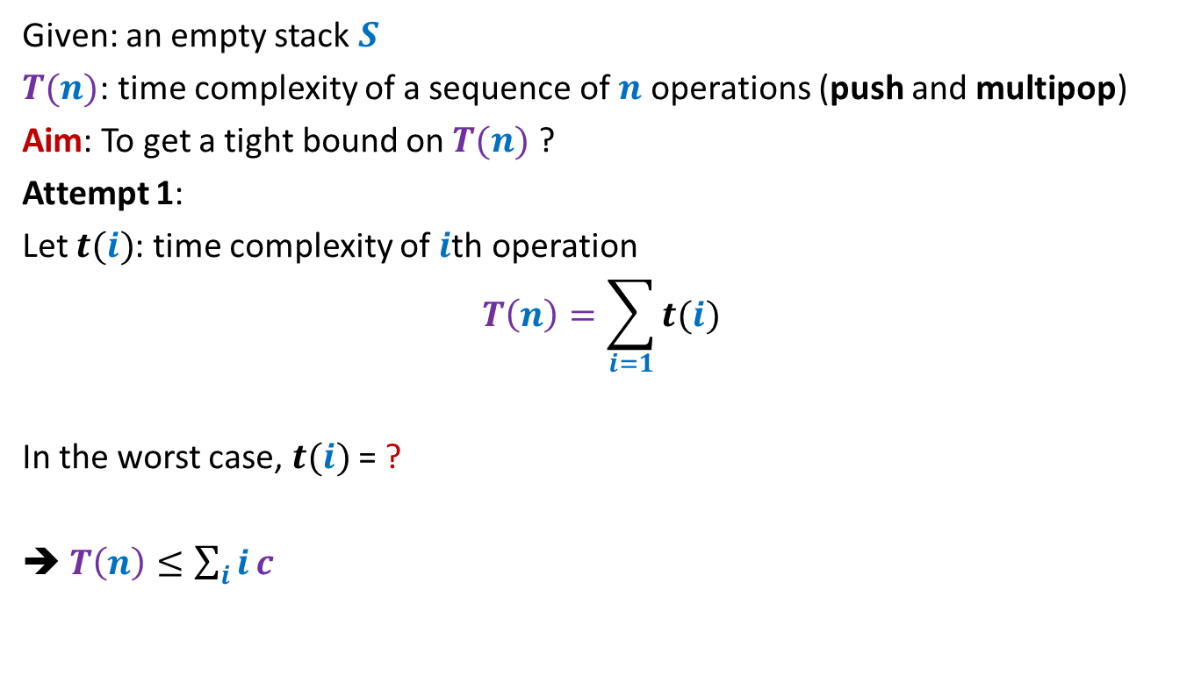

Stack with multi-pop
Given: an empty stack $S$
$T(n)$: time complexity of a sequence of $n$ operations (push and multipop)
Aim: To get a tight bound on $T(n)$ ?
Attempt 1:
Let $t(i)$: time complexity of $i$th operation
$$T\left(n\right)=\sum_{i=1}{t(i)}$$
In the worst case, $t(i)$ = ?
➔ $T\left(n\right)≤\sum_{i}{i}c$
$$(i−1) c$$
$$=O(n^{2})$$

Slide 21

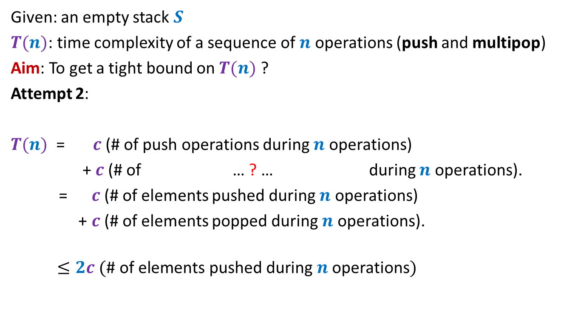
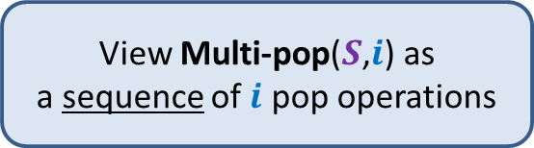

Stack with multi-pop
Given: an empty stack $S$
$T(n)$: time complexity of a sequence of $n$ operations (push and multipop)
Aim: To get a tight bound on $T(n)$ ?
Attempt 2:
$T(n)$ = $c$(# of push operations during $n$ operations)
+ $c$(# of … ? … during $n$ operations).
= $c$(# of elements pushed during $n$ operations)
+ $c$(# of elements popped during $n$ operations).
$$≤2c (\text{\# }\text{of} \text{elements} \text{pushed} \text{during} n \text{operations})$$
pop operations of all multipops
View Multi-pop($S$,$i$) as
a sequence of $i$ pop operations
$$≤2cn$$
$$=O(n)$$

Slide 22
Splay tree: A self organizing Binary search trees.
How to show that splay tree work so well ? It is too difficult to establish it without amortized analysis.

Slide 23
Amortized COST
Inspiration from potential energy

Slide 24

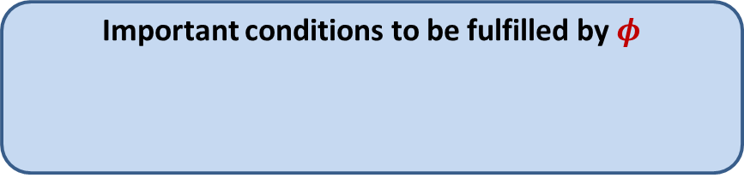




Amortized Cost
$φ$: potential function associated with the algorithm/data-structure
$φ(i)$: Potential at the end of $i$th operation
Amortized cost of $i$th operation $≝$ Actual cost of $i$th operation
Amortized cost of $n$ operations $≝$ $\sum_{i}{\text{Amortized} \text{cost} \text{of} i\text{th} \text{operation}}$
= Actual cost of $n$ operations
= Actual cost of $n$operations + $φ\left(n\right)$
$≥$ Actual cost of $n$operations
Important conditions to be fulfilled by $φ$
$φ(0)$ = $0$
$φ\left(i\right)≥0$ for all $i$
+ $\left(φ\left(i\right)−φ\left(i−1\right)\right)$
+ $\left(φ\left(n\right)−φ\left(0\right)\right)$

Slide 25


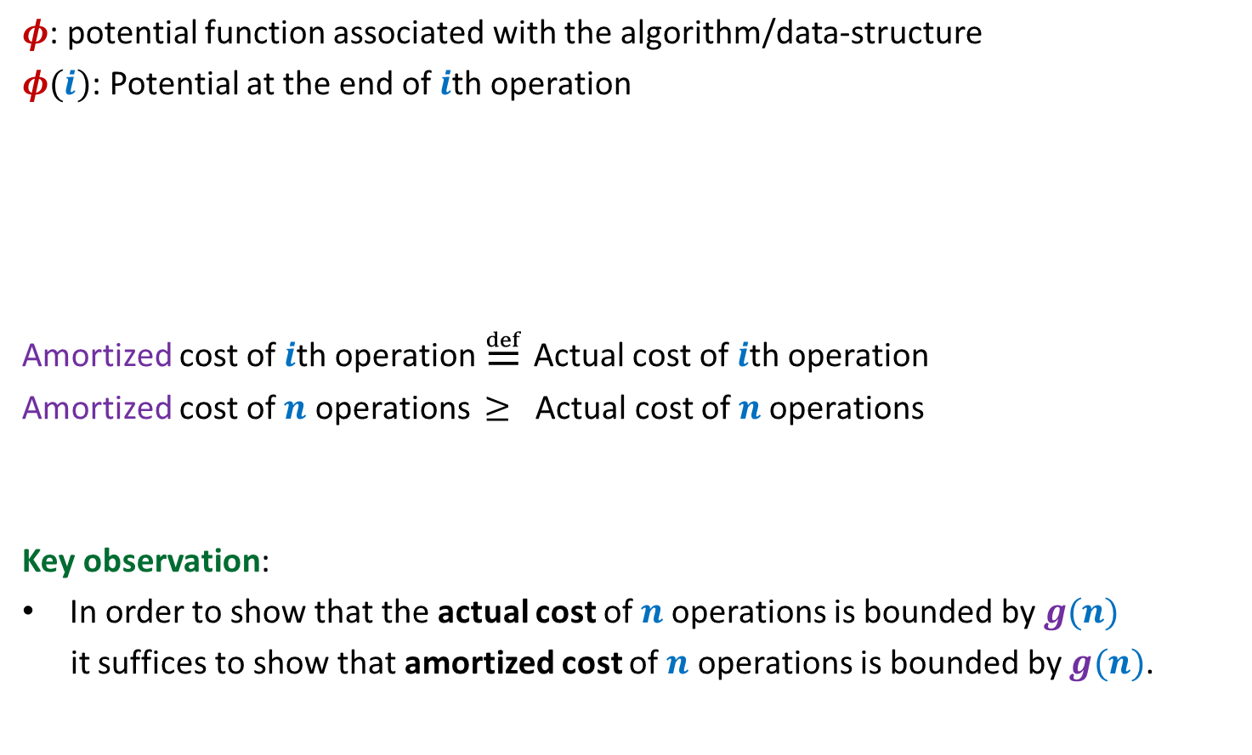
Amortized Cost
$φ$: potential function associated with the algorithm/data-structure
$φ(i)$: Potential at the end of $i$th operation
Amortized cost of $i$th operation $≝$ Actual cost of $i$th operation
Amortized cost of $n$ operations $≥$ Actual cost of $n$operations
Key observation:
In order to show that the actual cost of $n$operations is bounded by $g(n)$
it suffices to show that amortized cost of $n$ operations is bounded by $g(n)$.
Important conditions to be fulfilled by $φ$
$φ(0)$ = $0$
$φ\left(i\right)≥0$ for all $i$
+ $\left(φ\left(i\right)−φ\left(i−1\right)\right)$
$=O(g(n)$)
?
$O(g(n)$)

Slide 26


This is how it may work out
Actual cost
Amortized
cost
Amortized
cost
$$Δφ$$
+
+
+
+
Operations
Amortized cost
$$−$$
$$−$$
Operations

Slide 27

This is how it may work out
Actual cost
Amortized
cost
Amortized
cost
$$Δφ$$
+
+
+
+
Operations
Amortized cost
$$−$$
$$−$$
$$Δφ$$
Amortized
Cost of all operations
Operations

Slide 28
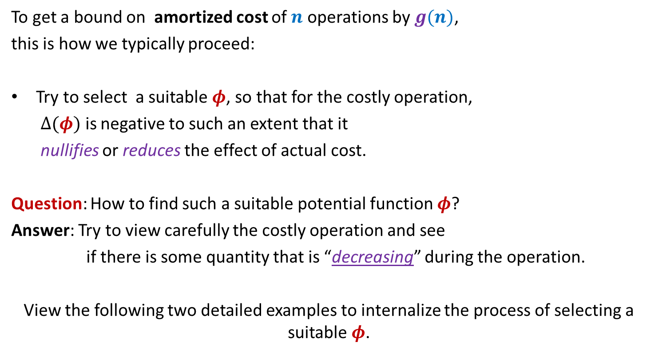
Amortized Cost
To get a bound on amortized cost of $n$ operations by $g(n)$,
this is how we typically proceed:
Try to select a suitable $φ$, so that for the costly operation,
$Δ(φ)$ is negative to such an extent that it
nullifies or reduces the effect of actual cost.
Question: How to find such a suitable potential function $φ$?
Answer: Try to view carefully the costly operation and see
if there is some quantity that is “decreasing” during the operation.
View the following two detailed examples to internalize the process of selecting a suitable $φ$.

Slide 29
amortized analysis of bit flips of a binary counter

Slide 30
A careful insight into increment
Algorithm for increment:
Keep scanning from right to left
Flip all the scanned bits.
0 | 0 | 1 | 1 | 0 | 1 | 1 | 0 | 0 | 0 | 0 | 0
0 | 0 | 1 | 1 | 0 | 1 | 0 | 0 | 0 | 0 | 1 | 0
0 | 0 | 1 | 1 | 0 | 1 | 0 | 1 | 1 | 1 | 1 | 1
0 | 0 | 1 | 1 | 0 | 1 | 0 | 0 | 0 | 0 | 0 | 1
till we get the first 0

Slide 31

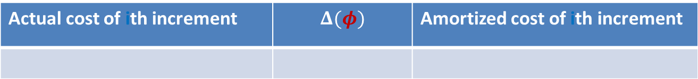








A careful insight into increment
Actual cost of $i$th increment =
0 | 0 | 1 | 1 | 0 | 1 | 1 | 0 | 0 | 0 | 0 | 0
0 | 0 | 1 | 1 | 0 | 1 | 0 | 0 | 0 | 0 | 1 | 0
0 | 0 | 1 | 1 | 0 | 1 | 0 | 1 | 1 | 1 | 1 | 1
0 | 0 | 1 | 1 | 0 | 1 | 0 | 0 | 0 | 0 | 0 | 1
$$k=5$$
$$k=1$$
1 + Length of longest suffix with all 1’s
Actual cost of ith increment | $$Δ(φ)$$ | Amortized cost of ith increment
$$k+1$$
$$−(k−1)$$
$$2$$
$φ$($i$): # of 1’s in the counter after $i$th increment
Amortized cost of $i$th increment $=2$
Amortized cost of $n$ increments $=2n=O(n)$
Actual cost of $n$ increments $=O(n)$

Slide 32

Homework
Question: What if we had used
$φ$: Length of longest suffix of 1’s

Slide 33
amortized analysis of Stack with multi-pop

Slide 34



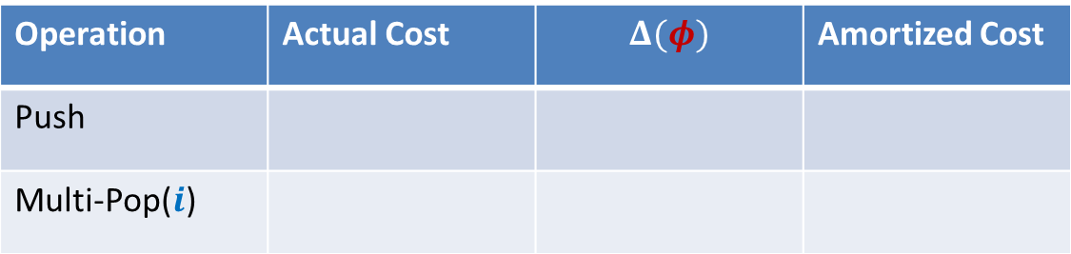






Stack with multi-pop
Multi-pop($S$,$i$)
Top
$i$ elements
$$S$$
$$S$$
Operation | Actual Cost | $$Δ(φ)$$ | Amortized Cost
Push
Multi-Pop($i$)
$$c$$
$$i c$$
$$−i c$$
$$0$$
$φ$($i$): $c$ (# elements in stack after $i$th operation)

Slide 35





Stack with multi-pop
Push($S$,$x$)
$$S$$
$$S$$
Operation | Actual Cost | $$Δ(φ)$$ | Amortized Cost
Push
Multi-Pop($i$)
$$c$$
$$c$$
$$2c$$
$$i c$$
$$−i c$$
$$0$$
$φ$($i$): $c$ (# elements in stack after $i$th operation)
Amortized cost of each operation $≤2c$
Amortized cost of $n$ operations $≤2nc=O(n)$
Actual cost of $n$ operations $=O(n)$

